Slide 1
SPEECH EMOTION RECOGNITION
TEAM NUMBER : HT009
SDG GOAL : 3 GOOD HEALTH AND WELL BEING
TEAM NAME : CHICKEN WINGS

Slide 2
Problem statement
Goal is to use a model-based approach for speech emotion recognition in real time environment.
Focuses on emotion detection through acted scenarios although people expresses their emotions by voice naturally.
Programmed to work on pipelined architecture and parallel processing.

Slide 3
OBJECTIVES
Speech Emotion Recognition is to improve human-machine interface.
It aims to track a person’s psychological status.
To recognize an emotion of a person precisely under noisy conditions.
Estimating the speech features of noise-corrupted emotional speeches reliably.
For making it essential to take rational as well as intelligent decisions

Slide 4
Dataset used
DESCRIPTION
SOURCE
Name : RAVDESS
It is multimodal database or emotional speech that has been validated.
The collection includes 24 professional actors who vocalized lexically-matched utterances in a neutral North American accent
https://www.kaggle.com/datasets/uwrfkaggler/ravdess-emotional-speech-audio

Slide 5





Tools and technologies used
JUPYTER NOTEBOOK
PYTHON
LIBROSA
NUMPY
PYAUDIO

Slide 6
WORKFLOW
Start
Speech Signal
Pre-Processing
Extraction of MFCC Features
Training Set
Separation of training and testing data
Testing Set
CNN Training
Accuracy
Testing
Testing Model
Stop

Slide 7
USES AND CHALLENGES
USE CASES
CHALLENGES
Asses Individual state with past and current stage
It can be used for Psychiatric diagnosis, automated call centers, assessing driver’s mental state
Datasets are recorded in silent labs but in real time the voice recorded seems to be noisy.
Accuracy is generally affected by extraction and selection of efficient feature
Getting the accurate emotion from a voice was a challenging task.

Slide 8
UNIQUENESS OF THE SOLUTION
Add some points
APRIL 2022
HACK@SRET
8

Slide 9
IMPACT AND STABILITY
At Contoso, we believe in giving 110%. By using our next-generation data architecture, we help organizations virtually manage agile workflows. We thrive because of our market knowledge and great team behind our product. As our CEO says, "Efficiencies will come from proactively transforming how we do business."​

Slide 10
Demonstration video

Slide 11

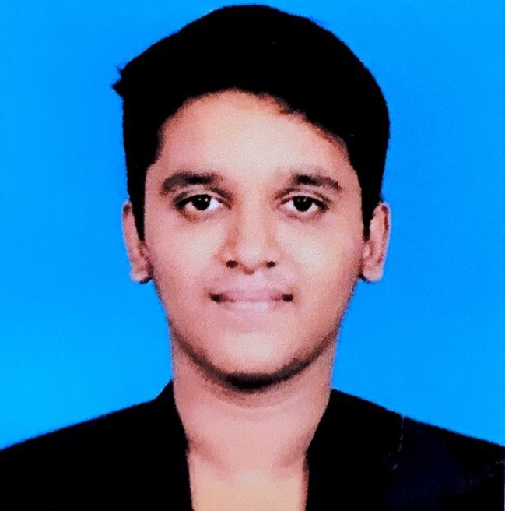
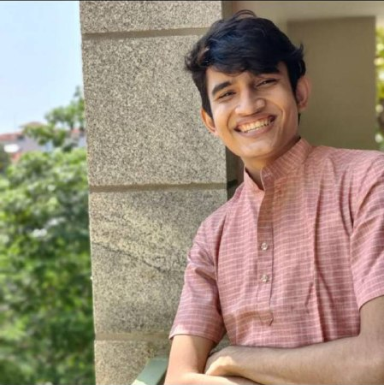

MEET OUR TEAM
KUMARESH N M
ADHITHYAN B
DHRISH S KUMAR
ROHIT A CH
E0320004
E0320005
E030008
E0320022

Slide 12
THANK YOU

